Slide 1

Cyclistic’s Annual Members versus
Casual Riders Ride Usage
Presented By: Elizabeth Martin
Last Updated: October 31st, 2022

Slide 2

Agenda
Objective
Data
Findings
Recommendation
Questions

Slide 3
Objective
To identify the differences in how annual members and casual riders use Cyclistic Bikes. In order to establish the best marketing strategy to convince casual riders to change to annual members.

Slide 4
Data
Source of data: Monthly data provided directly from the company’s website
Period covered: September 2021 to August 2022
Data anomalies were cleaned and removed. Anomalies included a few hundred entries when bikes were taken out of docks and checked for quality by Divvy or ride_length was negative.

Slide 5
Findings
Number of Trips
Overall
Monthly
Day of the Week
Overall
Trip Length
Overall
Type of Bike
Overall

Slide 6
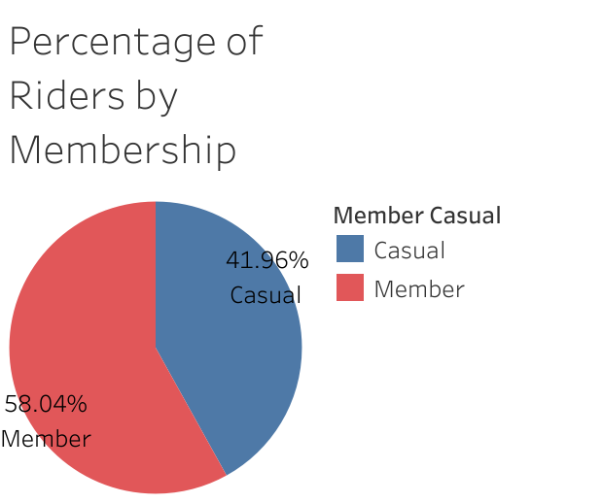
Percentage of Riders by Membership
Key Takeaways
There are more Member riders than Casual riders

Slide 7
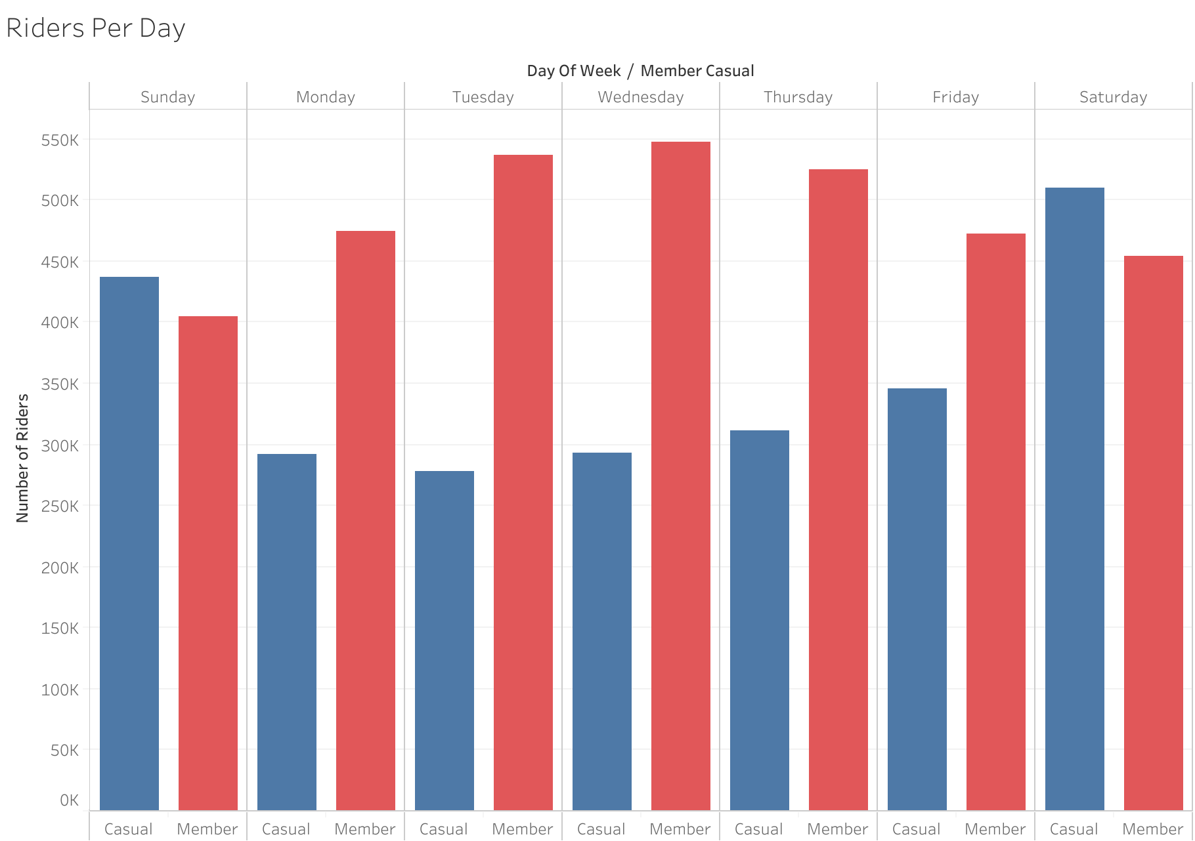
Riders Per Day
Key Takeaways
Casual Riders peak days were Saturday and Sunday
More Member Riders on the Weekdays

Slide 8
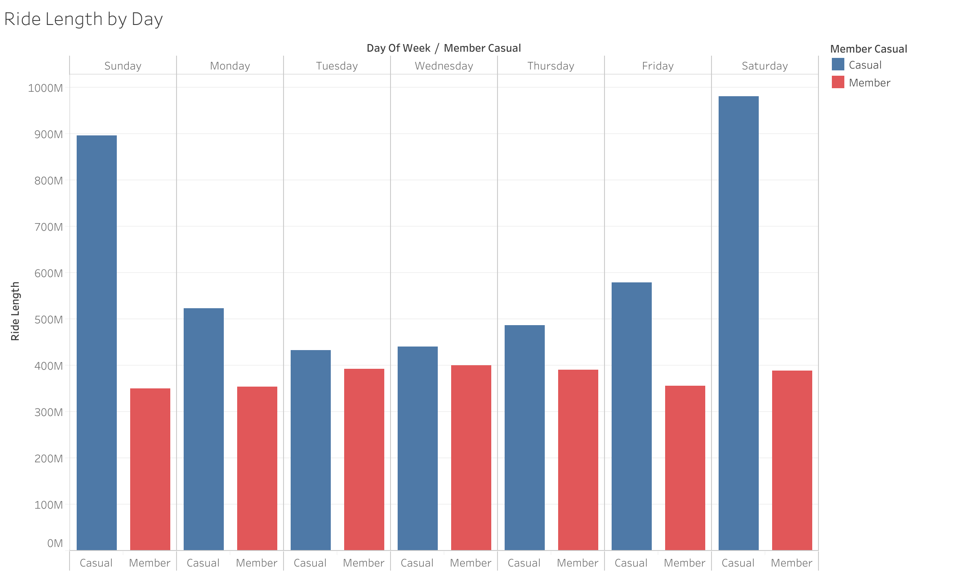
Ride Length by Day
Key Takeaways
Casual Riders rode a longer distance everyday
Saturday and Sunday are huge distance days for Casual Riders
Member Riders consistently rode between 300M and 400M everyday

Slide 9
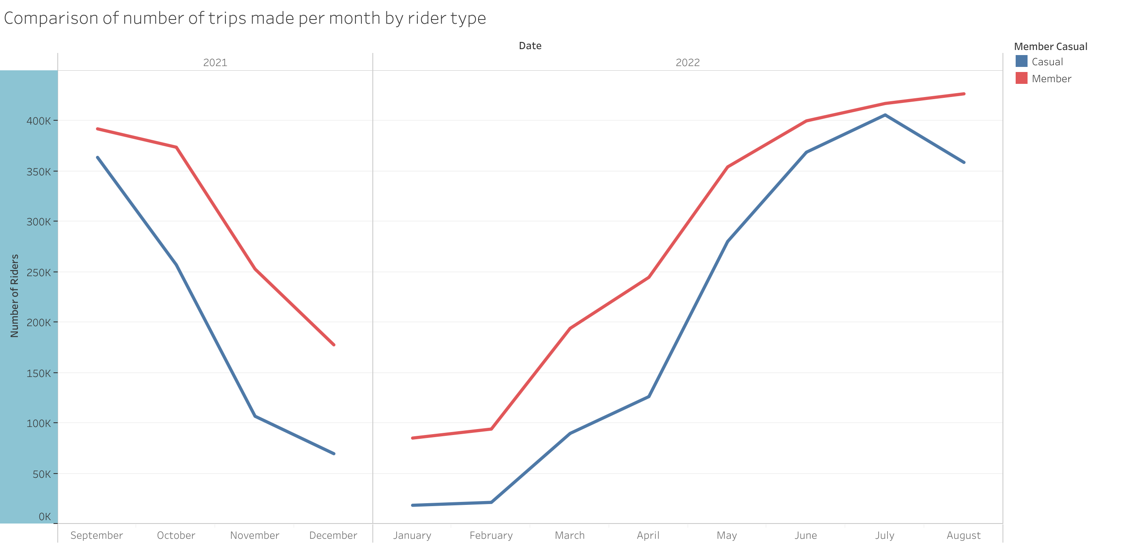
Comparison of Number of Trips Made per Month by Rider Type
Key Takeaways
The amount of riders decline during the winter months and increase in the Spring and Summer for both Members and Casual Riders

Slide 10
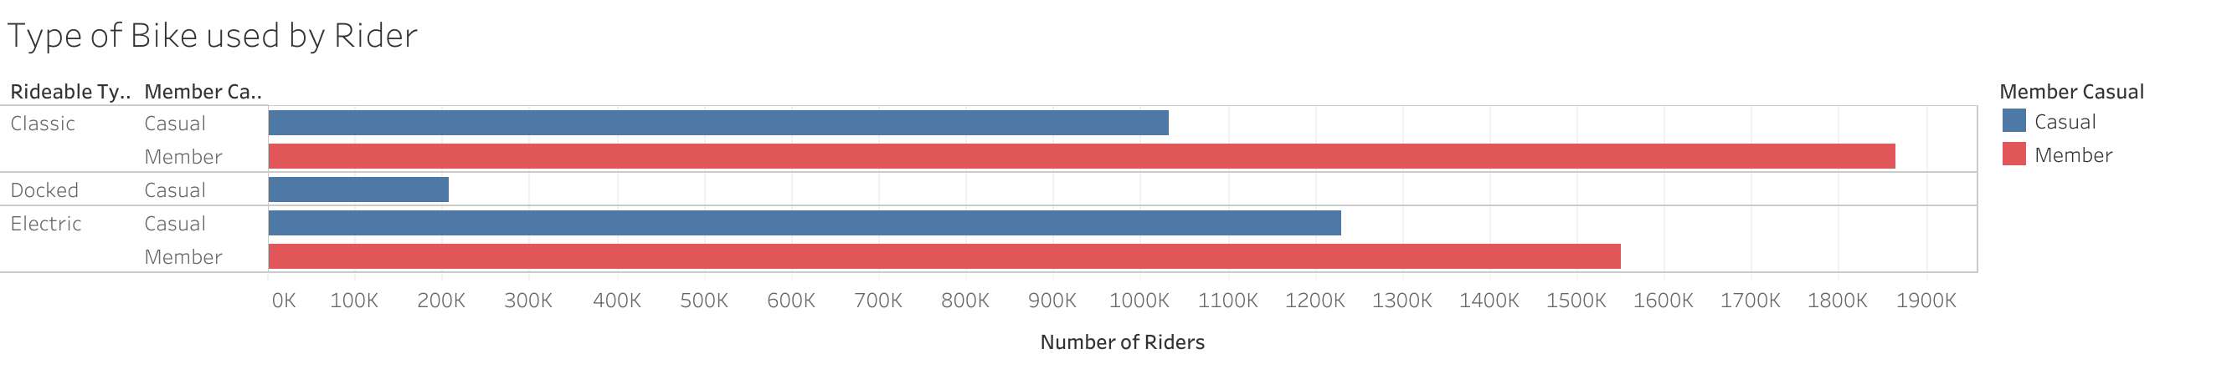
Type of Bike used by Rider
Key Takeaways
Casual Riders used Electric Bikes more than Classic Bikes
Member Riders preferred Classic to Electric Bikes

Slide 11
Recommendation
Clarify anomalies in the existing data
Trip Lengths with less than or equal to 0 - confirm these were test/ maintenance attempts
Start or End Station names were null
Gather more data for additional analysis
Look at 5 years prior to see if the seasons changing effect the number of rides

Slide 12
Questions
Thank You!
Questions?

